Slide 1

Machine Learning for Electricity Load Forecasting Internship
By Tantorn Dhippayom

Slide 2
Creating Database

Slide 3
1. Data Cleaning
https://github.com/tantornd/ML/tree/main/DataCleaning

Slide 4
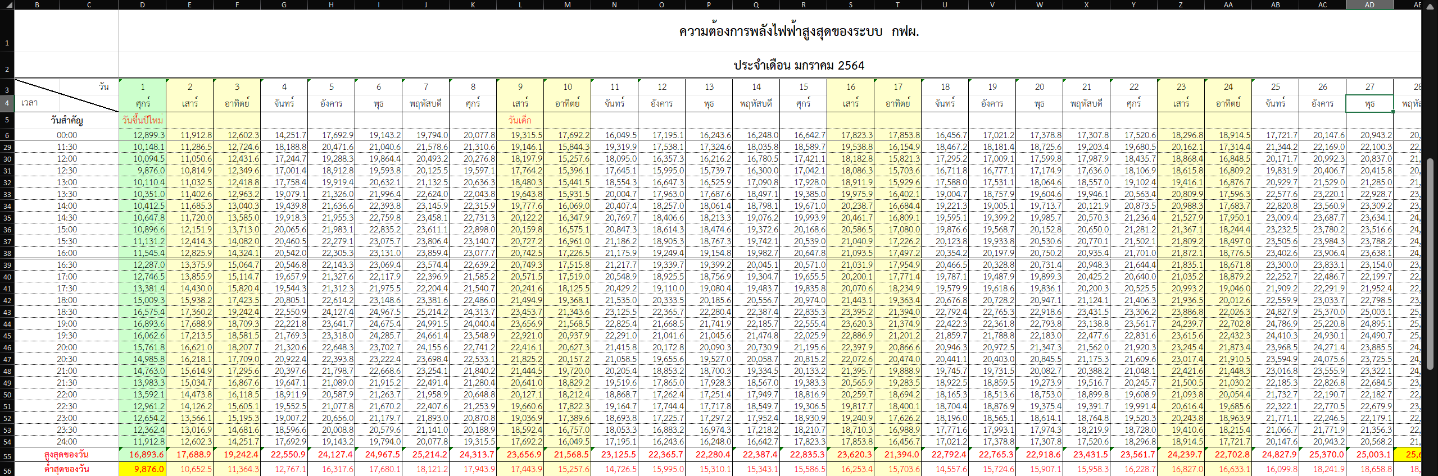

Slide 5
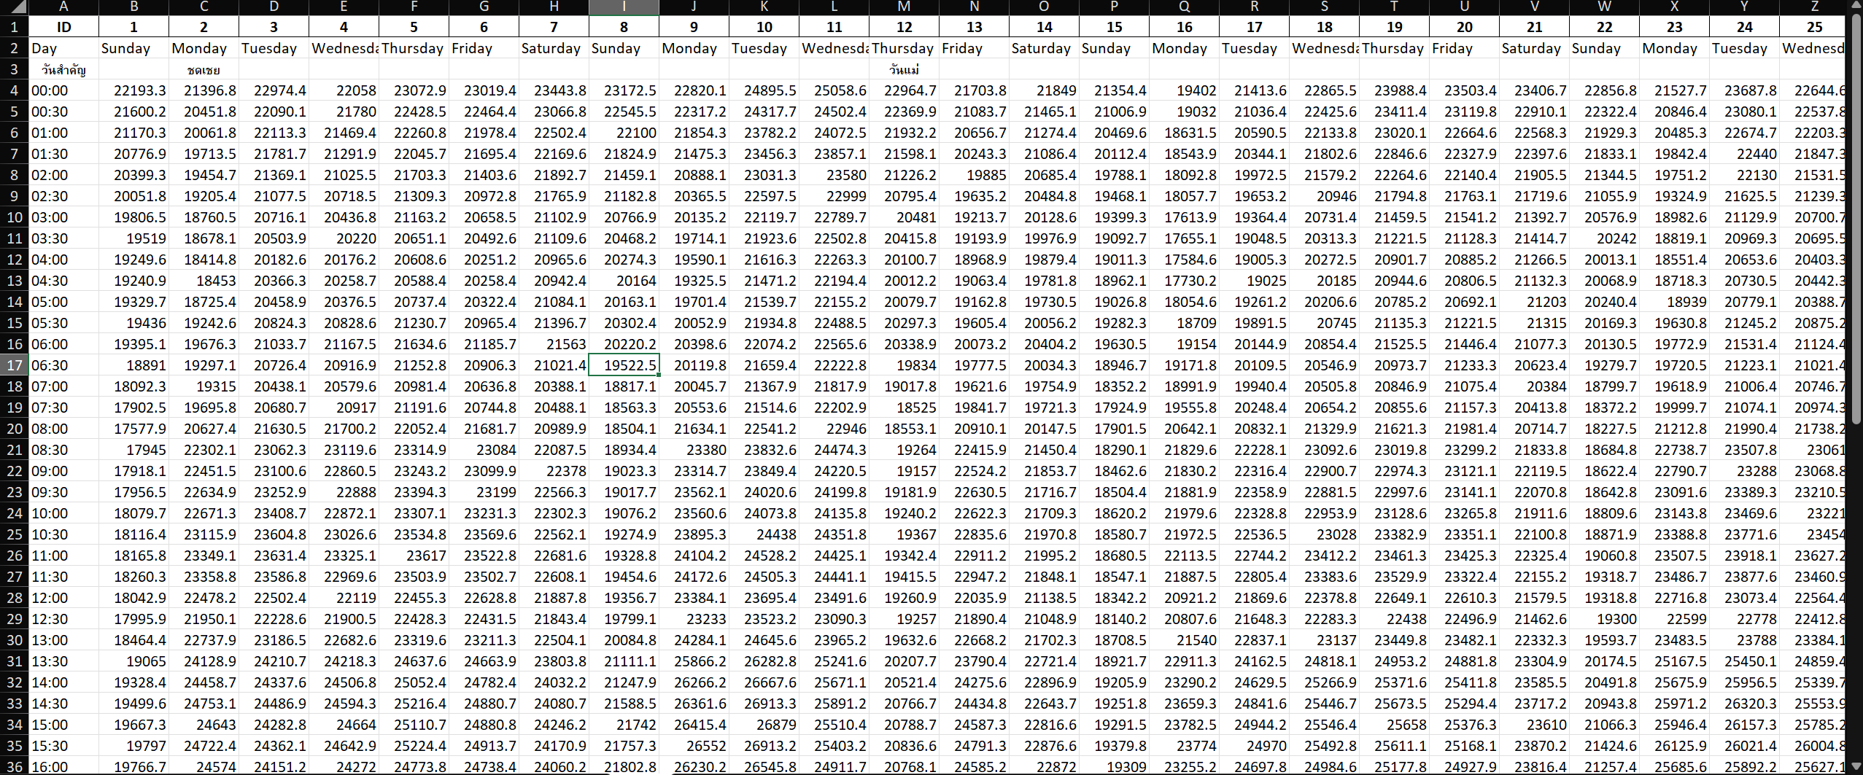

Slide 6
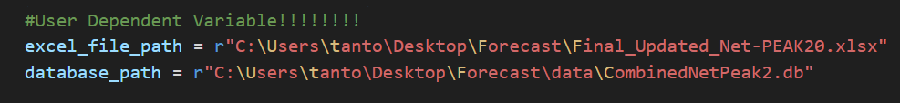
2. Creating Database
https://github.com/tantornd/ML/blob/main/Database/CreateDatabase.ipynb
https://github.com/tantornd/ML/blob/main/Database/Database.py
(Use the cleaned data)

Slide 7
Training the Linear Regression Model
Features:
X1 = Previous day at the same time
X2 = Previous 7 days at the same time
X3 = Previous 14 days at the same time

Slide 8
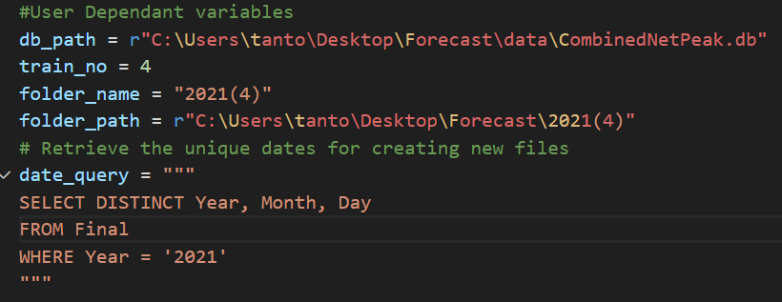
https://github.com/tantornd/ML/blob/main/Model/CombinedCode.py
Explanation: This code creates a folder that consists of varying training numbers (depending on the user) of every day in a certain year

Slide 9
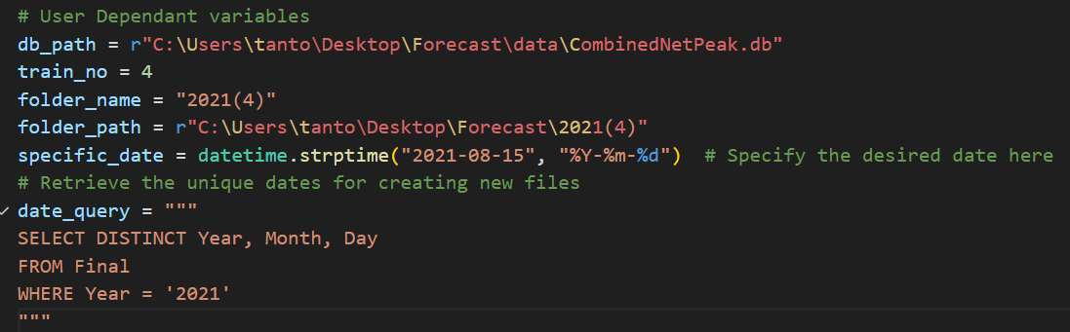
https://github.com/tantornd/ML/blob/main/Model/SpecificDate.py
Explanation: This code creates a folder that consists of varying training numbers (depending on the user) of a specific date

Slide 10
Training Number Comparison
https://github.com/tantornd/ML/blob/main/MAPE_Comparison.py
Generates an excel file comparing the MAPE of different days and month

Slide 11
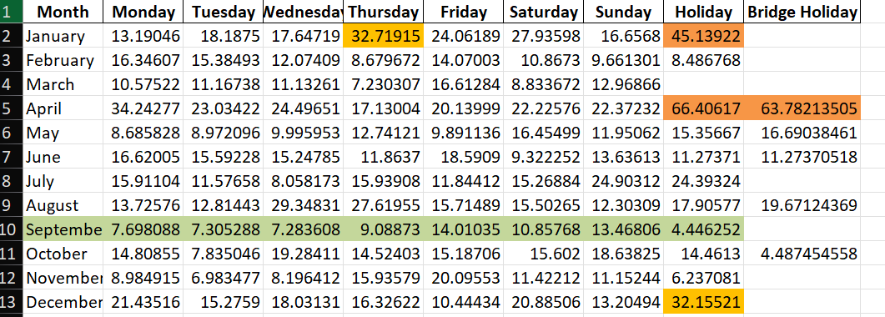
3 Training Data

Slide 12
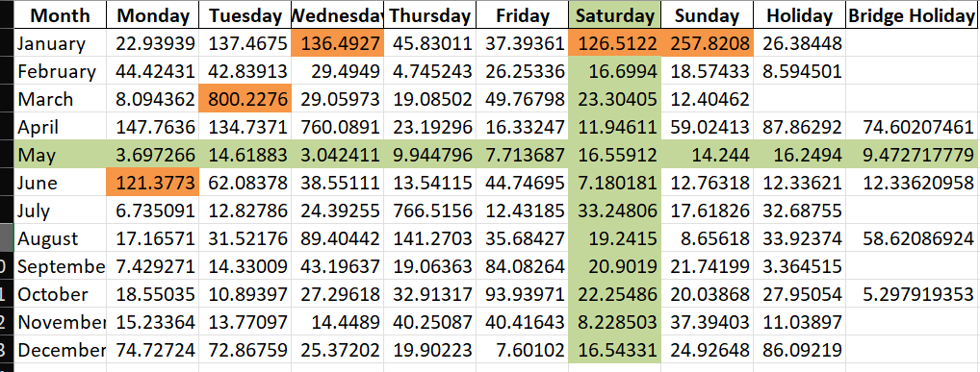
4 Training Data

Slide 13
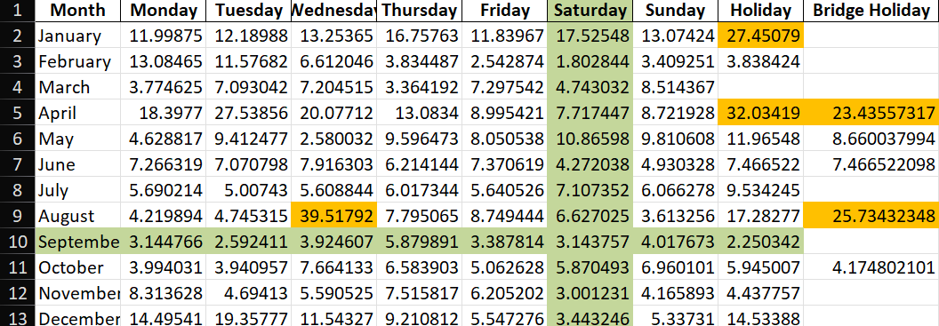
5 Training Data

Slide 14
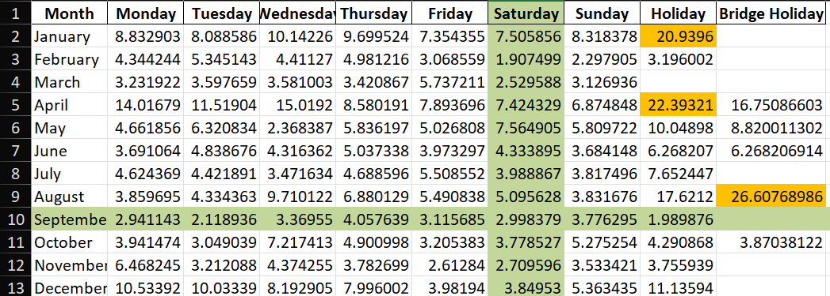
6 Training Data

Slide 15
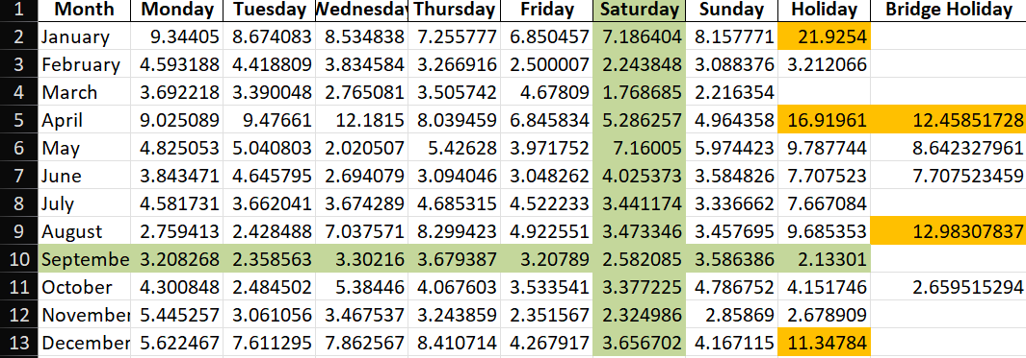
7 Training Data

Slide 16
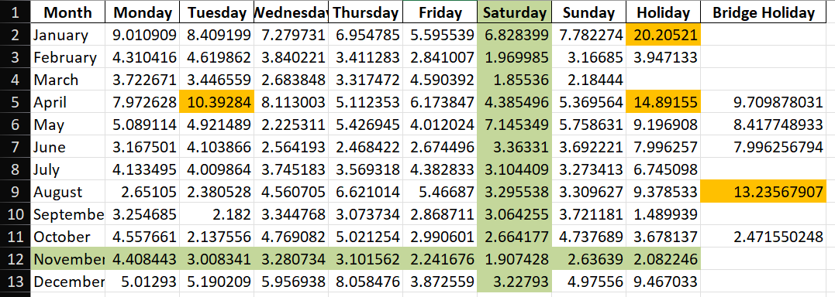
8 Training Data

Slide 17
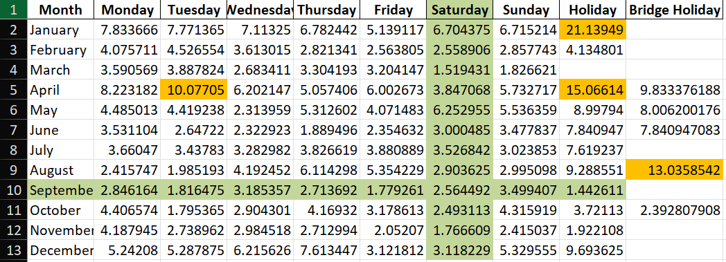
9 Training Data

Slide 18
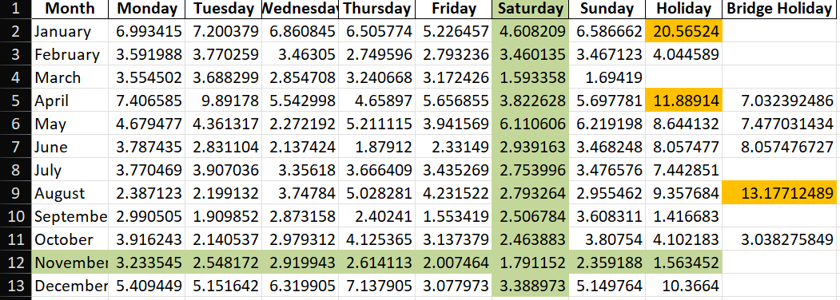
10 Training Data

Slide 19
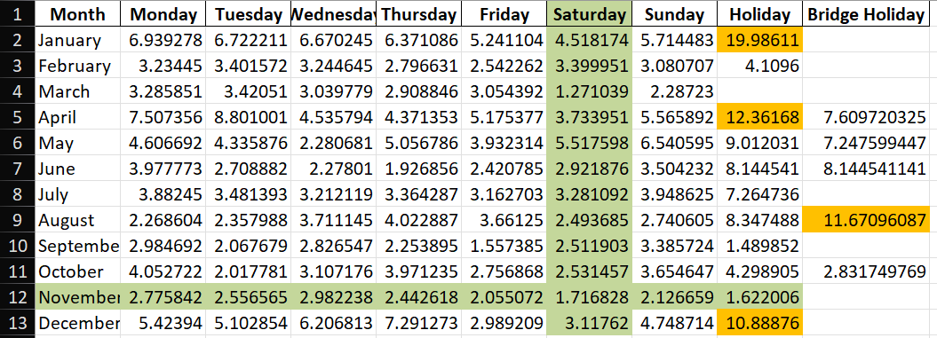
11 Training Data

Slide 20
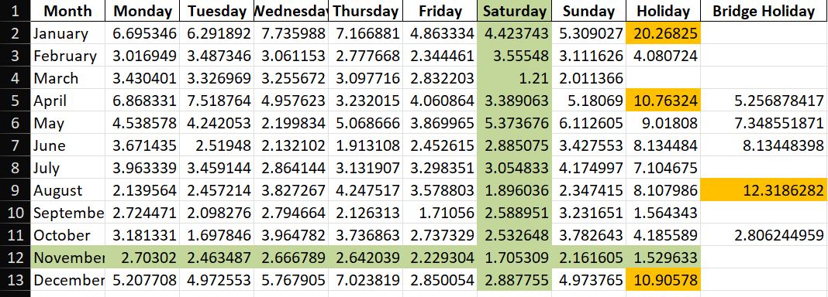
12 Training Data

Slide 21
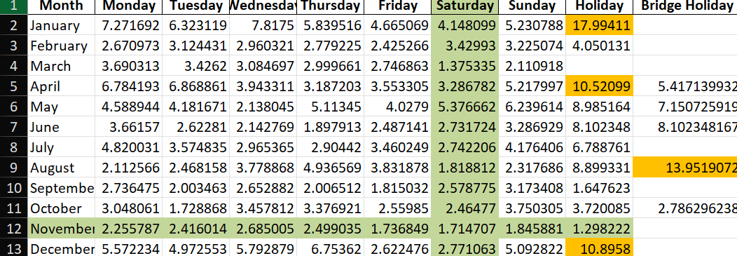
13 Training Data

Slide 22
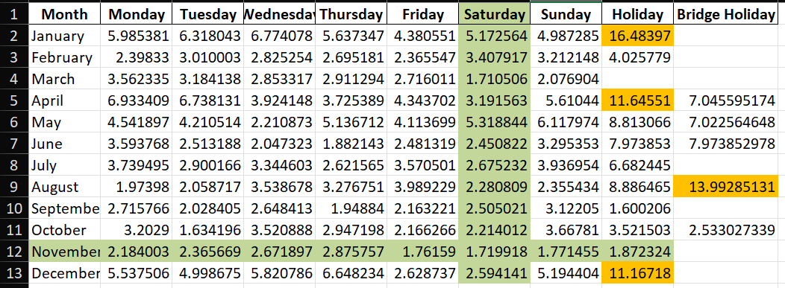
14 Training Data

Slide 23
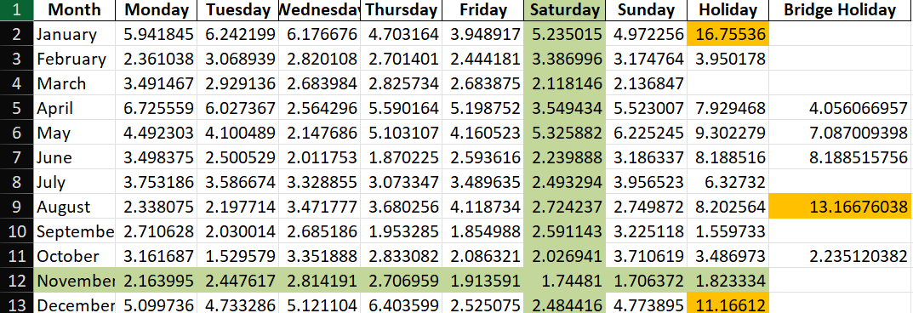
15 Training Data

Slide 24
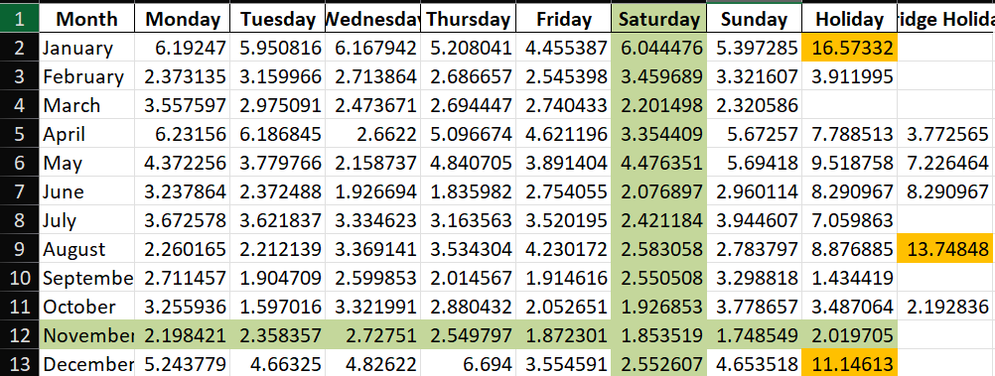
16 Training Data

Slide 25
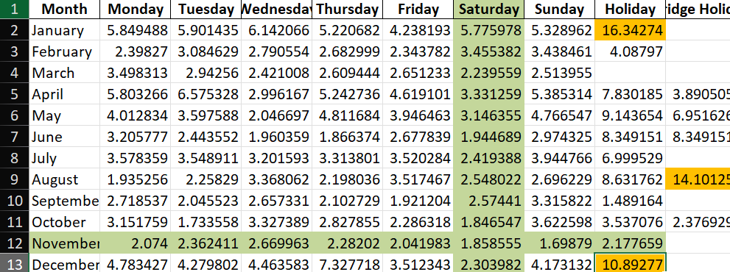
17 Training Data

Slide 26
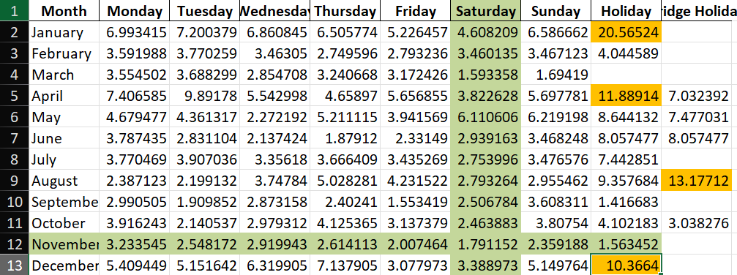
18 Training Data

Slide 27
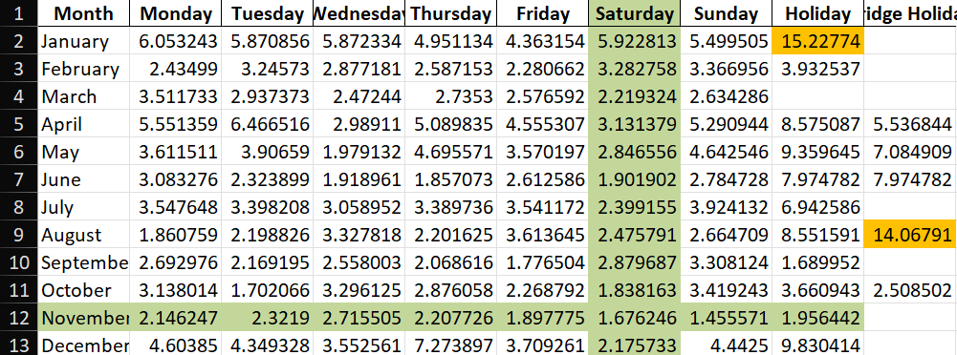
19 Training Data

Slide 28
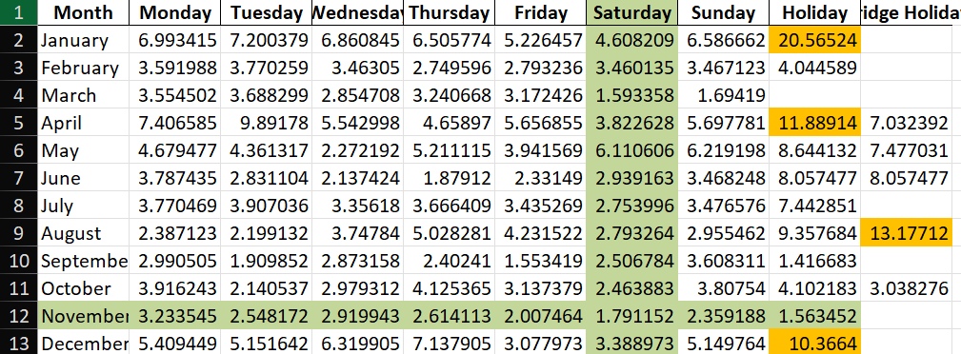
20 Training Data

